Slide 1


Slide 2
Climate Change in Canada
In 2011-2030, and 2011-2050
Henry Jacobs
University of Toronto

Slide 3
Introduction
Research questions
  How does moderate climate change by 2030 affect Canada's economy?
  How does the picture change in 2050?
How these questions will be answered
  Simulate crop yield impacts of climate change in rice, maize, and wheat industries
  Explore economy-wide effects of these yield changes
  Check how sensitive results are to elasticity assumptions

Slide 4
Model and Database
Standard GTAP model
Comparative static
v.9.0 2011 database

Slide 5
Model and Database
Regions
  Five regions: Canada, Temp-HY, Temp-LY, Trop-HY, Trop-LY
Temperate and tropical
    Based roughly on latitude; Challinor, et al. (2014)
Low income and high income categorization
    Based on World Bank classifications
    Consideration of convergence theory in baseline projections

Slide 6
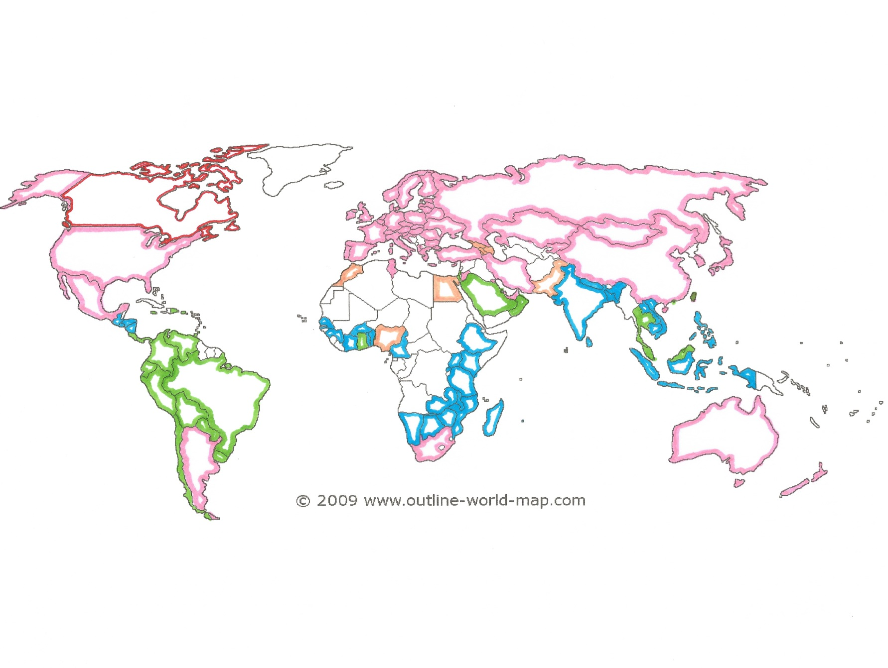

Slide 7
Model and Database
Six industries
Agricultural Industries
    Wheat, rice, and maize, other agriculture/natural resources
    Advantages:
      These grains account for large percentage of global food supply
      Matches raw yield data from Challinor, et al., 2014
      Wheat is 1.2% of Canadian exports
Manufacturing and services

Slide 8
Model and Database
Three factors of production
  Land, labor, capital
  All factors are fully mobile
Elasticities
  Standard, default GTAP elasticities
Closures
  Countries linked by trade, not by savings and investment, for clarity of results
  Default GTAP closures

Slide 9
Yield Data
Challinor, et. al, (2014)
  Meta-analysis of crop yield projections as a result of changes in temperature
  How my study utilized Challinor, et. al, 2014:
  borrowed the raw data relevant to approximately 2030 and 2050
  only included data on yields without adaptation
  includes mostly data from “middling” SRES scenarios A1 and B1
  organized crop yield projections by country, then aggregated into regions, weighted by land area
Nelson, et al. (2009)
  Supplemental data on maize yields

Slide 10
Baseline Scenarios: 2011-2030 and 2011-2050
  Solow growth model
  Factor supply growth: projected
  Factor neutral TFP growth
    Consistent with IASSA GDP growth rates

Slide 11
Macro Projections Data
Land:
  Alexandratos, et al. (2011)
  Report on strategies and policies for preparing global agriculture for 2050.
Labor and Capital stocks:
  Foure, et al. (2012)
  Report on growth scenarios for 147 countries based on the MaGE (Macroeconometrics of the Global Economy) model.
Real GDP and Population:
  International Institute for Applied Systems Analysis (2015)
  Shared Socioeconomic Pathways - SSP2 v.9 database

Slide 12
Climate change scenarios
Climate change scenarios:
  Baseline scenarios plus yield shocks for wheat, rice, and maize, for each region
Climate change impacts measured as the difference between the baseline and climate change scenarios

Slide 13
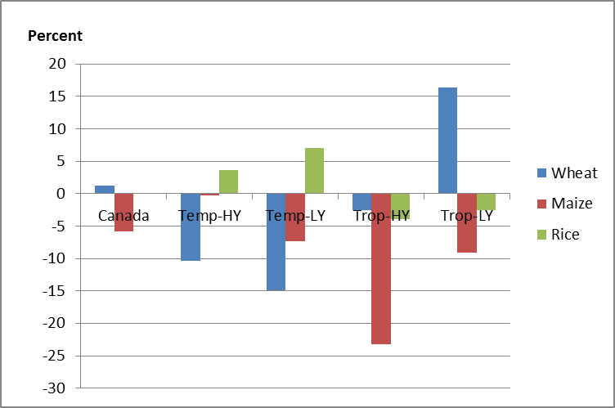
Percent Change in Crop Yields Across All Five Regions by 2030

Slide 14
results

Slide 15
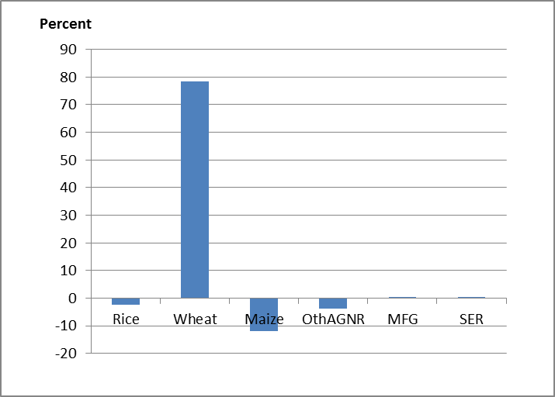
Percent Change in Canadian Output in 2030 Due to Climate Change

Slide 16
Change in welfare in 2030 due to climate change ($US millions)
 | Allocative efficiency | Endow. | Tech. Change | Pop. | TOT | I-S TOT | Total
Canada | -209 | -404 | -15 | 106 | 2,246 | -117 | 1,606
Temp-HY | 1,086 | -2,154 | -23,676 | -577 | 1,044 | -1,023 | -25,299
Temp-LY | 806 | -1,717 | -5,236 | -1,358 | -4,896 | -73 | -12,473
Trop-HY | -1,018 | -1,906 | -16,133 | -1,401 | -372 | 1,060 | -19,770
Trop-LY | -11,980 | -5,035 | -6,014 | -1,965 | 2,351 | 112 | -22,530

Slide 17
Decomposition of Canada Terms of Trade in 2030 climate change scenario ($US millions)
 | World Price | Export Price | Import Price | Total
Rice | -2 | 0 | 6 | 5
Wheat | 1,816 | -708 | 0 | 1,108
Maize | 30 | 150 | 9 | 189
Other Ag. | 62 | 709 | 20 | 792
Manufacturing | 64 | 56 | -5 | 115
Services | 47 | -4 | -4 | 38
Total | 2,018 | 203 | 25 | 2,246

Slide 18
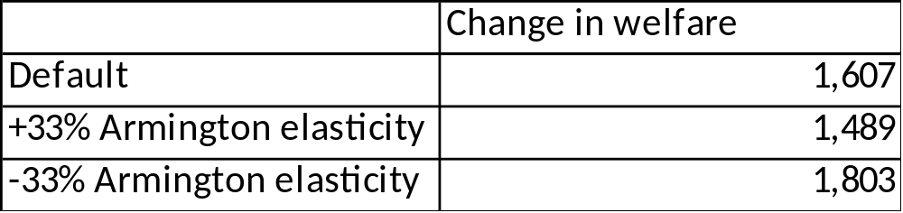
Change in Canadian welfare in 2030 due to climate change with different import demand elasticities ($US millions)

Slide 19
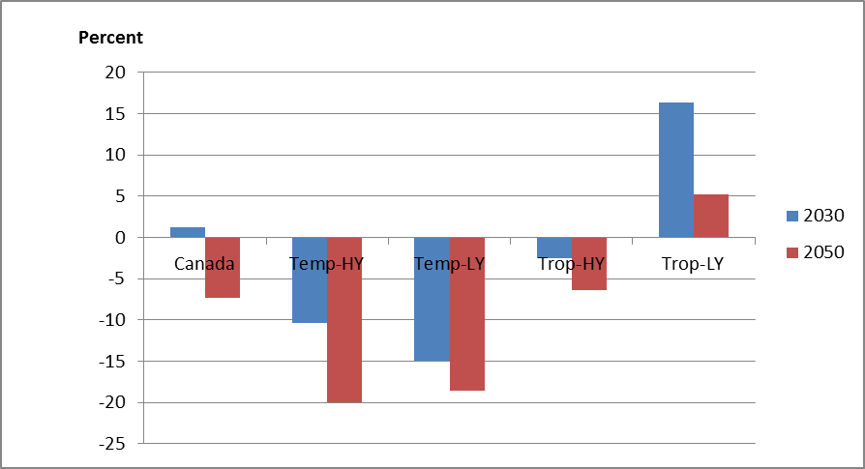

How does the picture change in 2050?

Slide 20
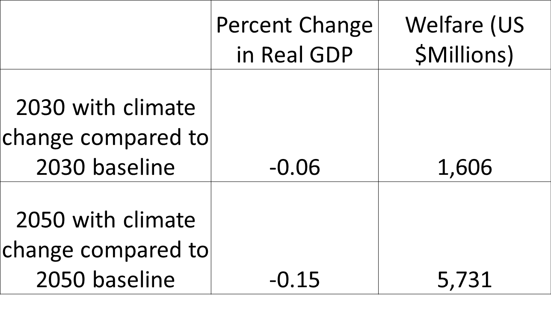
How does the picture change in 2050?

Slide 21
Comparison of results
Author and Date of Publication | Date of Analysis | Scenario | Adaptation? | Percent Change in Canadian GDP | Change in Canadian Welfare
Reillya, et al. (2007) | 2000-2100 | "POLFCTL" - no efforts to control GHGs | yes | - | ~0% by 2030 (represents change in consumption only)
Ronneberger, et al. (2008) | 1997-2050 | IPCC B1 | yes | <0.005 | negligible
Zhai, et al. (2009) | 2004-2080 | IPCC A2 | unspecified | -0.2 | .2 (EV as % of GDP)
Jacobs (2016) | 2011-2030 | Various | no | -0.02 | 1,074
 | 2011-2050 | Various | no | -0.15 | 5,731

Slide 22
conclusions
2030
  Yield changes will have economy-wide effects due to resource competition and rising export demand
  Canadian welfare increases entirely due to benefits to its terms of trade
  Canada’s real GDP shrinks modestly
2050
  Same pattern of effects, but to a greater degree
Caveats
  Limited scope of climate change impact
  One type of land only

Slide 23
citations
Alexandratos, N., et al. Looking Ahead in World Food and Agricultre: Perspectives to 2050. Rome: Food and Agriculture Organization, 2011. Accessed May 15, 2016. http://www.fao.org/docrep/014/i2280e/i2280e.pdf.
Challinor, A., et al. “A meta-analysis of crop yield under climate change and adaptation.” Nature Climate Change, 4 (2014): 287 – 291.
Nelson, G., et al. Climate Change: Climate change: Impact on agriculture and costs of adaptation. Washington: International Food Policy Research Institute, 2009. Accessed May 15, 2016. http://www.ifpri.org/publication/climate-change-1.
Fouré, J., A. Bénassy-Quéré, and L. Fontagné. The Great Shift: Macroeconomic projections for the world economy at the 2050 horizon. Paris: Centre d'Etudes Prospectives et d'Informations Internationales, 2012. Accessed May 15, 2016. http://www.cepii.fr/PDF_PUB/wp/2012/wp2012-03.pdf.
SSP Database." SSP Database. May 2015. Accessed May 15, 2016. https://tntcat.iiasa.ac.at/SspDb.
Cover Photo: Lawren Harris. Canadian, 1885-1970. Isolation Peak, Rocky Mountains, 1930.

Slide 24
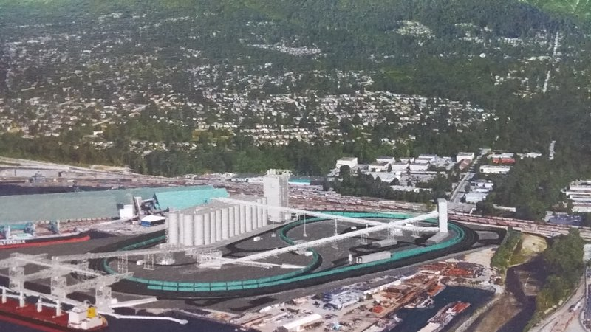
Proposed grain terminal at Vancouver port. January, 2016. Source: http://www.portvancouver.com/wp-content/uploads/2015/05/2016-01-14-Presentation-G3.pdf

