Slide 1
Global Plastic projections to 2050: economic drivers and environmental consequences
Ruben Bibas, Jean Chateau, Elisa Lanzi, Elonora Mavroedi, Daniel Ostalé Valribéras (OECD Environment Directorate)
2020 GTAP Conference
Notes:
Welcome

Slide 2
Motivation
Plastics are one of the most commonplace materials on the planet
  Global plastics production in 2015 reached 407 Mtpa), more than the production of paper (400 Mtpa) and aluminium (57 Mtpa).
The extraction of materials required for plastics production, including oil extraction and refining, as well as the use and disposal of plastic products is creating significant environmental pressure, with serious consequences for ecosystems and human well-being :
  plastic pollution.
  Plastic litter in the oceans (5 to 13 Mt are estimated to be introduced every year to the oceans)

Slide 3
Policy concerns
Increasing concerns and attention to improving the sustainability of plastics use:
- Osaka blue vision
Recent meetings and working group discussions at UN Environment Assembly has been exploring how to tackle marine plastic pollution.
March 2019, a non-binding resolution was made over throwaway items such as plastic bags and 170 countries have pledged to "significantly reduce" the use of plastics by 2030.
National plans:
October 2018, European Commission plan: to cut plastics waste, in particular single-use plastic litter polluting Europe's beaches and seas.
India continues preparations to abolish all single-use plastic by 2022
China’s plastic waste ban.

Slide 4
Projecting plastic lifecycle: empirical approaches
A new empirical literature has set up innovative methodologies to address this question by linking plastics use to economic growth projections. (Jambeck et al. (2015), Geyer et al. (2017), Lebreton and Andrady (2019), as well as Ryberg et al. (2019).
They employ different methodologies but all rely on empirical methods to estimate relationships….
In this empirical literature, the projected volumes of plastic follow aggregate economic growth and/or population growth, then are used to follow the corresponding amount of plastic wastes and plastic pollutions.
They all show that plastics production, use and waste generation will continue to rise to unprecedented levels in the coming decades in the absence of new policy action.
To develop a proper policy agenda, addressing plastic lifecycle would need to consider the underlying economic and structural drivers. Indeed, plastics is not a homogenous product, but instead refers to different plastics and uses. These various plastic flows have different lifetimes, waste management rates, recycling rates, which justifies the need for a sectoral perspective for plastics projections → Need to use structural/CGE model

Slide 5
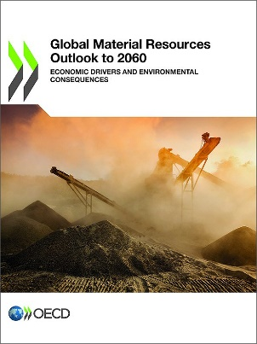
Methodology : modelling framework of the Global Material Outlooks
To model with a CGE plastics consumption (use), two main sources of data exist:
Data on plastics production and consumption by economic sector by GTAP10 for one generic plastic for 2011 and 2014 (all in monetary values)
Regional flows of plastics and global application-specific flows of plastics (all in tons) .
CGE Modelling – extending the ENV-Linkages Model to include Plastics sectors and plastic flows by polymer (ongoing) and a waste generation sector (work in progress).
Complemented by extended bottom up models for waste management modelling (recycling, incineration, unmanaged)

Slide 6
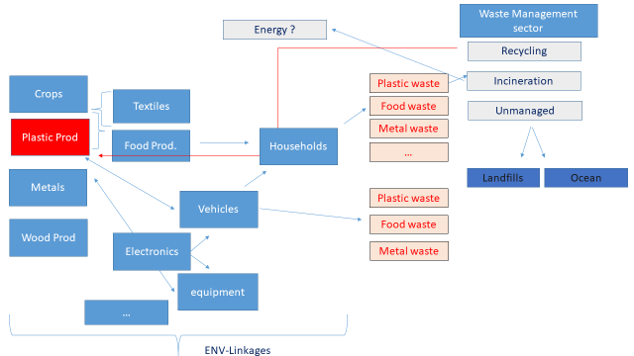
Toolkit
CGE Modelling – extending the ENV-Linkages Model to include Plastics sectors and a Waste generation sector
Complemented by extended bottom up models of plastic waste generation

Slide 7
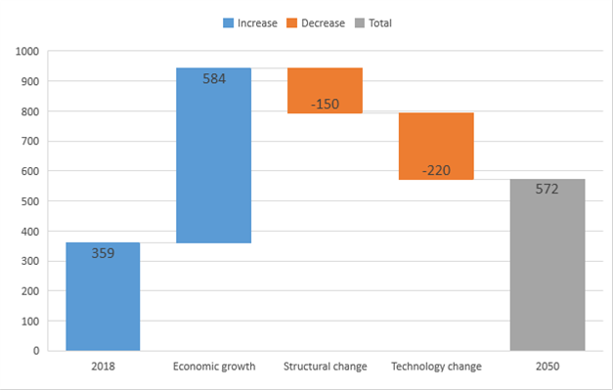
First results: plastic uses 2018-2050
Chart in Mt – global plastics (Includes Thermoplastics, Polyurethanes, Thermosets, Elastomers, Adhesives, Coatings and Sealants and PP-Fibers. Not included: PET-fibers, PA-fibers and Polyacryl-fibers.)
Source: OECD ENV-Linkages model

Slide 8
A big uncertainty about post covid-19 Long run projections
Need to update underlying baseline to take into account actual crisis
But no clear scenario now about:
  Duration of the crisis, time/delay across countries
  Strength and nature of policy boosts
  Long run impact on potential GDP (changes in behavior, structural changes,…)
→ More than ever need of multiple baselines

Slide 9
Next Steps:
Run multiple baselines
Incorporating various plastic waste management
Design policies

Slide 10
Thank you
Notes:
Welcome

